Slide 1
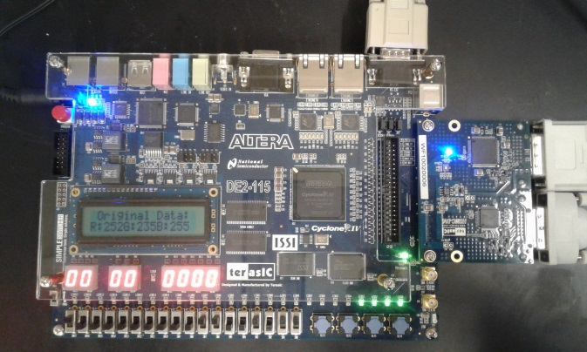
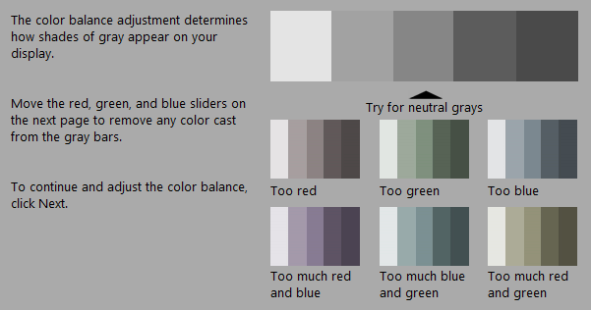
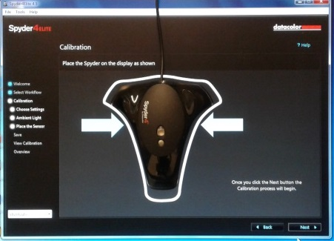
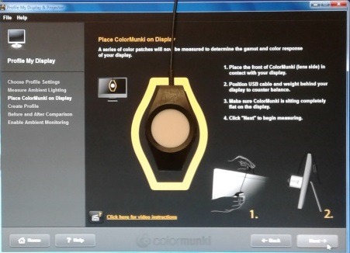
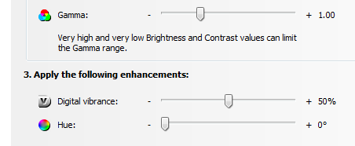
How Much Can Bad Display Calibration Cost?
Calvin Sun¹ and Wei-Chung Cheng²
¹Johns Hopkins University, Baltimore, MD; ²DIDSR/OSEL/CDRH, U.S. Food and Drug Administration, Silver Spring, MD
Experiments demonstrating impacts of mishandling color management for medical displays
Clinical Area: Medical Imaging
REGULATORY RELEVANCE
METHOD
FINDINGS
The first whole-slide imaging (WSI) device 510(k) de novo was granted on April 12, 2017 based on the Technical Performance Assessment guidance (TPA). Although the importance of color management of the display is stressed in the TPA guidance, many Sponsors are unaware of its significance and consider the display an independent, swappable component. In this poster, we demonstrate the potential errors introduced by mishandling of the color management system.
24 color patches
What does color calibration do?
Most color calibration tools adjust the gamma curve, gray tracking, and maximum luminance, but not color tracking, minimum luminance, etc.
Computer
Environment
Calibration Tool | Gamma | Gray Tracking | Max Luminance
Windows | Yes | Yes | No
ColorMunki | Yes | Yes | Yes
Spyder | Yes | Yes | Yes
Color
Manager
Color
Profile
Color
Calibration
Tool
Are calibrated displays all the same?
No. The calibration results vary greatly among the three calibration tools as shown in the plot.
Graphics Card
Driver
ABSTRACT
Which color manager should I use?
You can choose any one but choose only one. Existence of multiple color managers creates confusion for not only the user but also the applications. For example:
Experiments were conducted to examine the impact of mishandling color profile, color manager, and graphics card driver for color medical displays. Three color profiles, three color managers, and two graphics card settings were tested. A novel test method using a reconfigurable circuit board was designed and used to measure the output digital pixel values. The experiment results show the entanglement between the color management components from different vendors.
Display
Pixel Meter
Installed Color Manager | ICC profile is decided by
Windows only | latest setting by Windows
Windows and ColorMunki | latest setting by Windows or ColorMunki
Windows and Spyder | latest setting by Spyder
Windows, ColorMunki, and Spyder | latest setting by Spyder
Fig. 1: Color Management Components.
Color Profile: generated by Windows, Spyder, or ColorMunki
How do I use an existing ICC color profile?
Depends on the color managers:
Installed Color Manager | How to choose ICC | Acceptable ICC profiles generated by
Windows | Use “Color Management” | Windows, ColorMunki, Spyder
ColorMunki | Not available | ColorMunki (only the latest calibration)
Spyder4 | Use “ProfileChooser” | Spyder
INTRODUCTION
The color management components within the computer environment are depicted in Fig. 1. The basic idea of color management is to compensate for the uncalibrated display errors by modifying the RGB values received from the applications before they are sent to the display. The color profile contains the color transformation for a specific display. The color profile is generated by a color calibration tool. The color manager controls which color profile to use. The graphics card driver executes the color transformation and frequently offers extra features to adjust the display colors. The Pixel Meter is a circuit board that monitors the digital RGB values on the DVI display interface.
Color Manager: color profile chosen by Windows, Spyder, or ColorMunki
Should I use graphics card software to adjust my display color?
Not recommended because it conflicts with the color profile (e.g., color profile overrides the Gamma setting but not the Digital Vibrance setting).
Graphics Card Software (nVidia Control Panel)
Gamma = 1.0, 1.2, 1.4, or 1.6
Digital Vibrance = 50% or 100%
How much does bad calibration cost?
A 3MP medical display costs $9,500 (Barco MDCC6430). A comparable non-medical display costs $2,000 (NEC EA304WMI-BK-SV). The dE₀₀ between them is 6.12. If the $7,500 difference is paid for the color difference, then the cost is 7500/6.12 = $1,225 per dE₀₀. Thus the worst calibration in our experiments (10.94 dE₀₀) is worse than no calibration and can cost as much as $13,400.
RESULTS
Use CIEDE2000 (dE₀₀) to calculate the color differences of the 24 color patches
The average of 24 dE₀₀ values are shown in the following table.
CONCLUSION
Color Profile | D.V.=50% | D.V.=100%
None | 0.00 | 7.45
Windows | 7.48 | 10.94
Spyder | 3.81 | 9.90
ColorMunki | 4.35 | 7.96
Unlike grayscale displays, calibration of color medical displays is tightly coupled with the computer environment, which needs to be properly addressed in 510(k) submissions for WSI devices.
FUNDING SOURCE
This study was supported by Critical Path Initiative and ORISE.
2017 OSEL Annual Student Science Poster Exhibit, August 2, 2017

